Slide 1
Chinook Database
Insights and analysis
Udacity – FWD – Advanced Data analysis Course
First project – july-2022
Prepared by : Ahmed Hamdy Ibrahim Khalil
ahmedkhalil010@gmail.com

Slide 2
Q1 : What are the top 10 ordered albums based on sales?
# | Album name | Total sales
1 | Battlestar Galactica (Classic), Season 1 | 35.82 $
2 | The Office, Season 3 | 31.84 $
3 | Minha Historia | 26.73 $
4 | Lost, Season 2 | 25.87 $
5 | Heroes, Season 1 | 25.87 $
6 | Greatest Hits | 25.74 $
7 | Unplugged | 24.75 $
8 | Battlestar Galactica, Season 3 | 23.88 $
9 | Lost, Season 3 | 21.89 $
10 | Acústico | 21.78 $
Generally, We have 347 album available , 304 album is used by customers , while 43 album is not used
From the above chart , it is clear that , “Battlestar Galactica both S1 and S3 are in the top 10 based on sales with (59.7 $). Also , Lost series S2 and S3 in addition to lost S1(11th) are of big sales with (67.66 $ ).

Slide 3
Q2 : What are the top 10 albums based on number of orders?
# | Album name | total orders
1 | Greatest Hits | 25
2 | Minha Historia | 23
3 | Unplugged | 23
4 | Battlestar Galactica (Classic), Season 1 | 18
5 | Acústico | 18
6 | Greatest Kiss | 17
7 | My Generation - The Very Best Of The Who | 17
8 | Prenda Minha | 16
9 | Chronicle, Vol. 2 | 16
10 | Acústico MTV | 16
When comparing the two bar charts , we can notice that (only 4 albums are having the big quantity of orders with big sales , while 6 of the best on sales are not in the top ordered tracks.

Slide 4
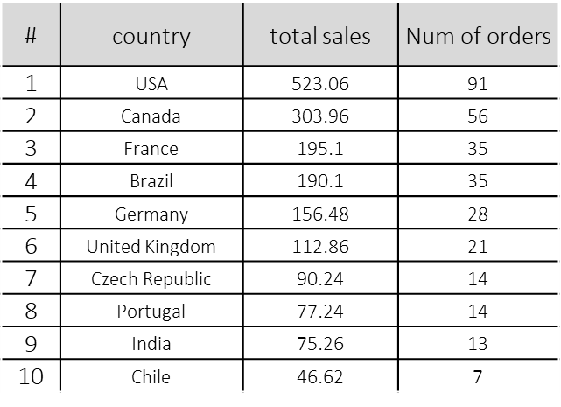
Q3: where do chinook exist?
Top 10 countries in sales
From 2009 to 2013 Chinook reached 24 countries , the 10 top countries in sales are shown , while the remaining countries are nearly the same in their size ( 7 orders with average 40 $ sales)

Slide 5
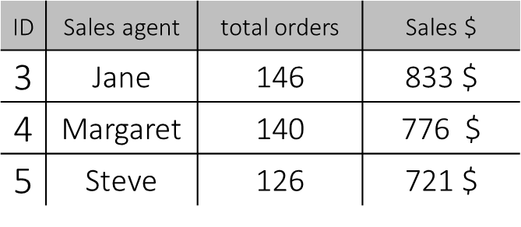
Q4: who is the best sales agent based on sales?
“Jane Peacock “
is the top sales agent comparing both total orders and total sales.
With the three sales agents responsible for supporting customers, total sales reached (2328 $ )

